Slide 1
Filter Basics
A filter is used to remove (or attenuate) unwanted frequencies in an audio signal
“Stop Band” – the part of the frequency spectrum that is attenuated by a filter
“Pass Band” – part of the frequency spectrum that is unaffected by a filter
Filters are usually described in terms of their “frequency responses,” e.g. low pass, high pass, band pass, band reject (or notch)

Slide 2
Essential Terminology
Cutoff Frequency – point in the stop band where frequencies have been attenuated by 3 dB (½-power)
Center Frequency – mid-point of the pass band in a Band Pass filter or the stop band of a Band Reject filter
Band Width – distance (in Hertz) between the ½-power points of a Band Pass or Band Reject filter

Slide 3
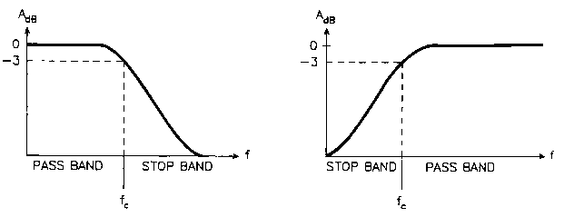
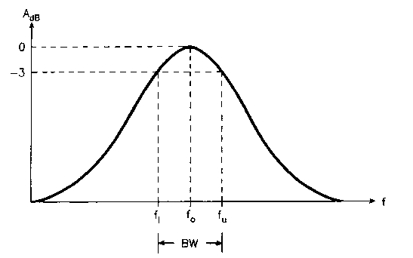
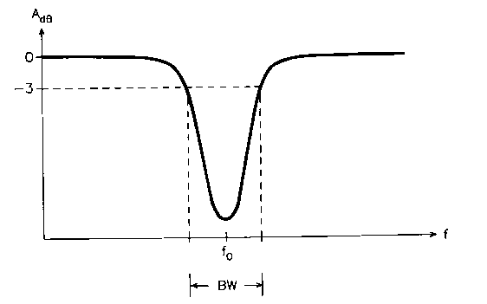
Frequency Response Curves
Low Pass
High Pass
Band Pass
Band Reject

Slide 4
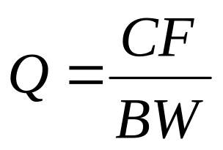
Other Important Terms
Slope – rate of attenuation within the stop band, measured in dB/Octave
Q – the Quality of a filter. Definition:
Q is often a more useful parameter than BW, because the BW needs to vary with the CF to keep the same “musical interval”
The higher the Q, the narrower the Band Width, and in BP filters, the more resonance may occur at the Center Frequency

Slide 5
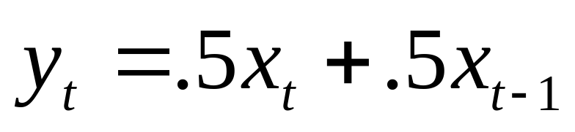
Basic Info on Digital Filters
All digital filters utilize one or more previous inputs and/or outputs
A very simple digital filter:
The current output is the average of the current input and the previous input
A “moving average” filter, it has a low pass characteristic and a Finite Impulse Response

Slide 6
More Digital Filter Basics
The Impulse Response of a filter is the output that will be produced from a single, instantaneous burst of energy, or “impulse”
Given the input signal {1,0,0,0,0…}, the filter y(t)=.5x(t)+.5x(t-1) will output the signal {.5,.5,0,0,0…}, a “finite impulse response”
A filter that uses only current and previous inputs produces a Finite Impulse Response, but a filter that employs previous outputs (a so-called “recursive filter”) produces an Infinite Impulse Response
If y(t) = .5x(t) + .5y(t-1), the impulse response is {.5,.25,.125,.0625,.03125…etc.}

Slide 7
Digital Filter Basics, cont.
The Order of a filter is a measure of its complexity
In a digital filter, the Order is proportional to the number of terms in its equation
The Slope of the attenuation within the stop band of a filter is approximately –6 dB per Order of that filter
Combining 2 filters by connecting them in series will double the total order, and hence, double the steepness of the slope

Slide 8
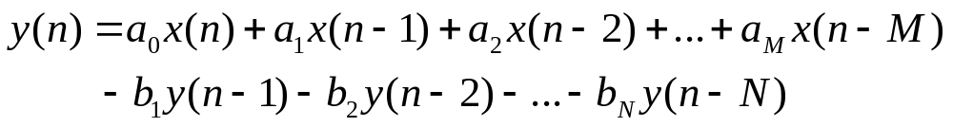
Digital Filter Basics, cont.
Filters are often described in terms of poles and zeros
  A pole is a peak produced in the output spectrum
  A zero is a valley (not really zero)
FIR (non-recursive) filters produce zeros, while IIR (recursive) filters produce poles.
Filters combining both past inputs and past outputs can produce both poles and zeros

Slide 9
Basic Csound Filter Opcodes
tone | Simple 1st-order low pass filter
atone | Simple 1st-order high pass filter
reson | General-purpose 2nd-order filter
butterlp | Nice 2nd-order low pass filter
butterhp | Nice 2nd-order high pass filter
butterbp | Nice 2nd-order band pass filter
butterbr | Nice 2nd-order band reject filter

Slide 10
Syntax
ar tone asig, khp[, iskip]
ar atone asig, khp[, iskip]
ar reson asig, kcf, kbw[, iscl, iskip]
ar areson asig, kcf, kbw[, iscl, iskip]
ar butterhp asig, kfreq[, iskip]
ar butterlp asig, kfreq[, iskip]
ar butterbp asig, kfreq, kband[, iskip]
ar butterbr asig, kfreq, kband[, iskip]
Note: reson can be used as a low pass filter by setting kcf
to 0, or as a high pass filter by setting kcf to sr/2

Slide 11
Notes on Csound filter units
All the above units are recursive, IIR filters
They have an internal storage array that holds previous outputs. By default, it is initialized to 0. Most Csound filters allow this to be skipped via their iskip argument
Recursive filters are inherently unstable, and may require amplitude scaling
Reson has an iscl argument: 0 = no scaling, 1 = pitch; 2 = noise

Slide 12
Amplitude Scaling Units
kr rms asig[, ihp, iskip]
ar gain asig, krms[, ihp, iskip]
ar balance asig, acomp[, ihp, iskip]
rms | Traces RMS amp of input signal
gain | Adusts input signal to RMS amp
balance | Balances input signal with comparator

Slide 13
Assignment
Read:
  Dodge Chapter 6, pp. 169-200
  Roads pp. 184-194 and 397-419 (opt.)
Read Csound Manual descriptions of all the filters and scaling units covered.
Experiment!

